Slide 1
Introduction to Algorithm Design
Lecture Notes 8

Slide 2
ROAD MAP
Dynamic Programming
  The Knapsack Problem
  All Pairs Shortest Paths
  Optimal Binary Search Tree
  String Editing
  Matrix Chain Product

Slide 3
Dynamic Programming
Definition :
  Dynamic programming is an interesting algorithm design technique for optimizing multistage decision problems
  Programming in the name of this technique stands for planning
    Does not refer to computer programming
  It is a technique for solving problems with overlapping subproblems
    Typically these subproblems arise from a recurrence relations
    Suggests solving each of the smaller subproblems only once and recording the results in a table

Slide 4
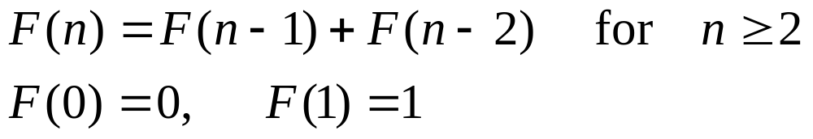
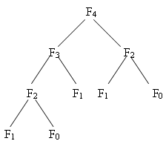
Example 1: Fibonacci Numbers
    top-down solution: divide & conquer - > O(2^{n})
    bottom-up solution: dynamic programming
      calculate F₂, F₃, then F₄ on a table - > O(n)

Slide 5
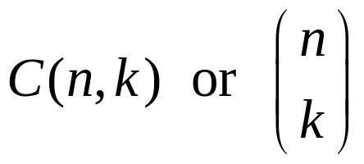

Example 2: Binomial Coefficient
Definition :
  Binomial coefficient is the number of combinations (subsets) of k elements from an n element set (0≤k≤n)
  Binomial coefficient comes from the participation of these numbers in binomial formula
  Recursive definition of Binomial coefficients

Slide 6
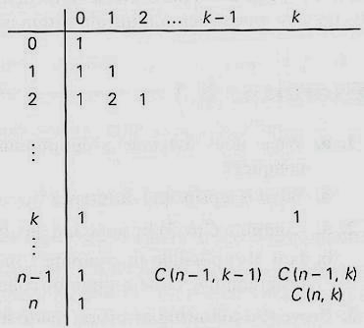
Example 2: Binomial Coefficient
Use a table with n+1 rows and k+1 columns

Slide 7
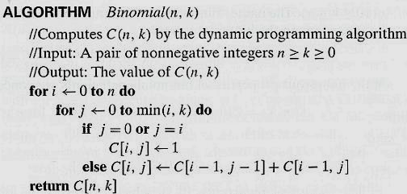
Example 2: Binomial Coefficient

Slide 8
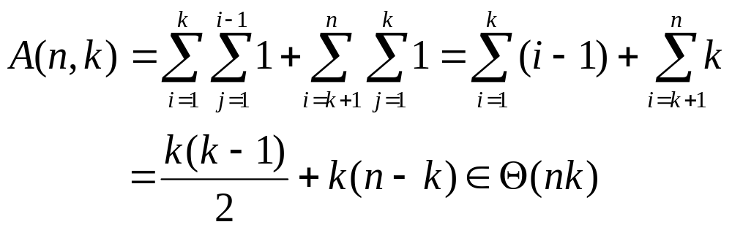
Example 2: Binomial Coefficient
Analysis :
  Basic operation in algorithm is addition
  Computing each entry requires one addition
  First k+1 rows of the table from a triangle while the remaining n-k rows from a rectangle
  So we split the sum expression into two parts

Slide 9
Dynamic Programming
Dynamic programming usually used for optimization problems
  How do we get the recurrence relation?

Slide 10
0/1 Knapsack Problem
Definition:
  Given n items of known weights w₁, w₂, …, w_{n} and values v₁, …, v_{n} and a knapsack of capacity W
    Assume w₁, w₂, …, w_{n} and W are intergers
  Find the most valuable subset of the items that fit into the knapsack
  How can we design a dynamic programming algorithm ?

Slide 11
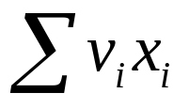
Dynamic Programming
  1. Sequence of decisions
  Ex : 0/1 Knapsack problem
    decide values (0 or 1) of x_{i} (1 ≤ i ≤ n) one by one
  is maximized
    To get the optimal solution
      No error in decisions
      Try all possible decisions

Slide 12
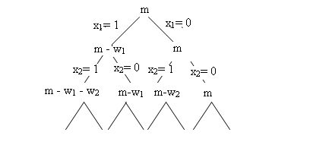
Dynamic Programming
  2. Try all decision sequences
  Ex : 0/1 Knapsack problem
  Dynamic programming
    enumerate the decisions (problems arise after the decision) that can lead to optimal solution and reuse them

Slide 13
Dynamic Programming
  3. Principle of Optimality
  Assume an optimal sequence of decisions. Whatever the initial state and first decision the remaining sequence of decisions is an optimal sequence from the state after the first decision

Slide 14
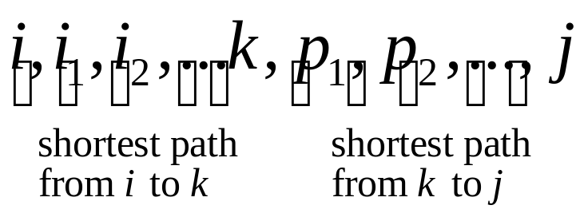
Dynamic Programming
Ex : Shortest Path Problem
    in a directed graph if
    i, i₁ ,i₂,…, i_{k}, j is shortest path from i to j
    then
    i₁, i₂,…, i_{k}, j is shortest path from i₁ to j
    OR

Slide 15
Dynamic Programming
Ex : 0/1 Knapsack Problem
x₁,x₂,…,x_{n} is optimal for KNAP(1,n,W)
if x_{n} = 0
x₁,…,x_{n-1} is optimal for KNAP(1,n-1,W)
if x₁ = 1
x₁,…,x_{n-1} is optimal for KNAP(1,n-1,W-w₁)

Slide 16
Dynamic Programming
  4. Write a recurrence relation for the optimal solution
  S₀ → initial state
  d_{i} → decisions to be made 1<i<n
  D₁ → {r₁ r₂ … r_{k}} possible decisions for d₁
  S_{i} → state after d₁ = r_{i}
  T_{i} → optimal sequence of decisions after S_{i}
  By principal of optimality:
    optimal sequence from S₀ is
    the best of r_{i}T_{i} 1<i<k

Slide 17
Dynamic Programming
  Ex : 0/1 Knapsack problem
  V(n,W)→ optimal value for KNAP(1,n,W)
  V(i,j)→ optimal value for KNAP(1,i,j)
  V(n,W) → max {V(n-1,W), V(n-1,W-wn)+vn}
  V(i,j) → max {V(i-1,j), V(i-1,j-wn)+vn}

Slide 18
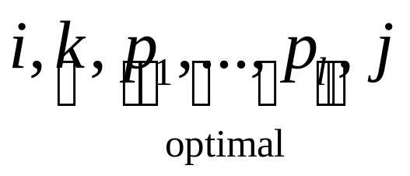
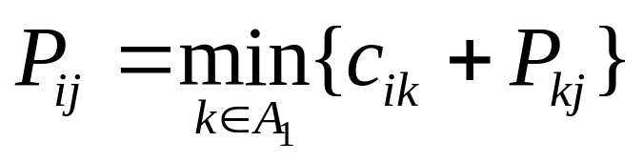
Dynamic Programming
Ex : Shortest Path Problem
  A₁ = set of vertices from i

Slide 19
ROAD MAP
Dynamic Programming
  The Knapsack Problem
  All Pairs Shortest Paths
  Optimal Binary Search Tree
  String Editing
  Matrix Chain Product

Slide 20
Knapsack Problem
Definition:
  Given n items of known weights w₁, w₂, …, w_{n} and values v₁, …, v_{n} and a knapsack of capacity W
  Find the most valuable subset of the items that fit into the knapsack
  How can we design a dynamic programming algorithm ?

Slide 21
Knapsack Problem
Approach :
  We need to derive a recurrence relation
    expresses a solution to an instance of the problem in terms of solutions to its smaller subinstances
  Consider an instance defined by the first i items 1≤i≤n
    with weights w₁, …, w_{i}
    values v₁, …, v_{i}
    capacity j 1≤j≤W
  V[i, j] be the value of an optimal solution to this instance
    Total value of the most suitable subset of first i items that fit into the knapsack of capacity j

Slide 22
Knapsack Problem
Approach :
We can divide all subsets of the first i items that fit the knapsack of capacity j into two categories
1. Among the subsets that do not include the i^{th} item,
  the value of an optimal subset is, V[ i-1, j ]
2. Among the subsets that do include the i^{th} item,
  an optimal subset is made up of
    this item and
    an optimal subset of the first i-1 items that fit into the knapsack of capacity j-w_{i} (j-w_{i} ≥ 0)
  The value of such an optimal subset is v_{i}+ V[i-1, j-w_{i}]

Slide 23
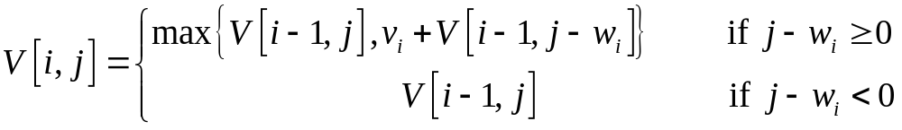
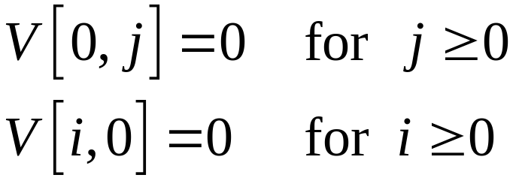
Knapsack Problem
So, the following recurrence
Initial conditions
How to solve this recurrence??

Slide 24
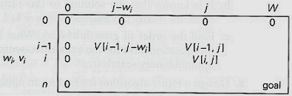
Knapsack Problem
Table for solving the knapsack problem by dynamic programming

Slide 25
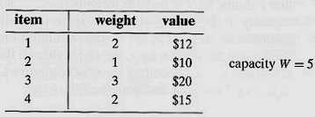
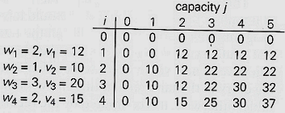
Example :
The given instance
Maximal value is V[4, 5] = 37
Dynamic programming table

Slide 26
Knapsack Problem
Analysis :
  Time efficiency and space effciency of this algorithm is Θ(nW)
  The time needed to find the composition of an optimal solution is in O(n+W)

Slide 27
ROAD MAP
Dynamic Programming
  Computing a Binomial Coefficient
  The Knapsack Problem
  All Pairs Shortest Paths
    Floyd’s Algorithm
  Optimal Binary Search Tree
  String Editing
  Matrix Chain Product

Slide 28
All-Pair Shortest Path Problem
Definition:
  Given a weighted graph G,
    G has no cycle with negative length
  Compute the distances (the length of the shortest paths) between every pair of vertices in a graph G
  Specifically:
  Find D = Distance matrix
  where d_{ij} = length of the shortest path from i to j

Slide 29
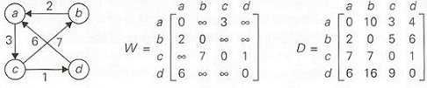
All-Pair Shortest Path Problem
Digraph weight matrix distance matrix

Slide 30
All-Pair Shortest Path Problem
What is the sequence of decisions?
What are possible choices at each decision point?
What about principle of optimality…
How to write the recurrence relation?

Slide 31
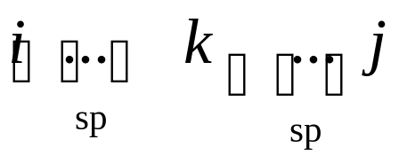
All-Pair Shortest Path Problem
Idea:
  Compute D through a series of n-by-n matrices
  W=D⁽⁰⁾, …, D^{(k-1)}, D^{(k)}, …, D^{(n)}=D
  where d_{ij}^{(k)} = the length of the shortest path from i^{th} vertex to j^{th} vertex with each intermediate vertex, if any, numbered not higher than k
    k is the largest index on the path
  Optimal path from i to j contains no cycle
    Vertex k appears only once on the path
  Because of the principle of optimality

Slide 32
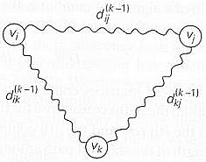
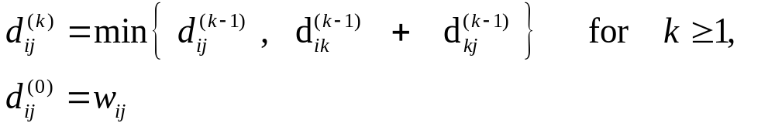
Floyd’s Algorithm

Slide 33
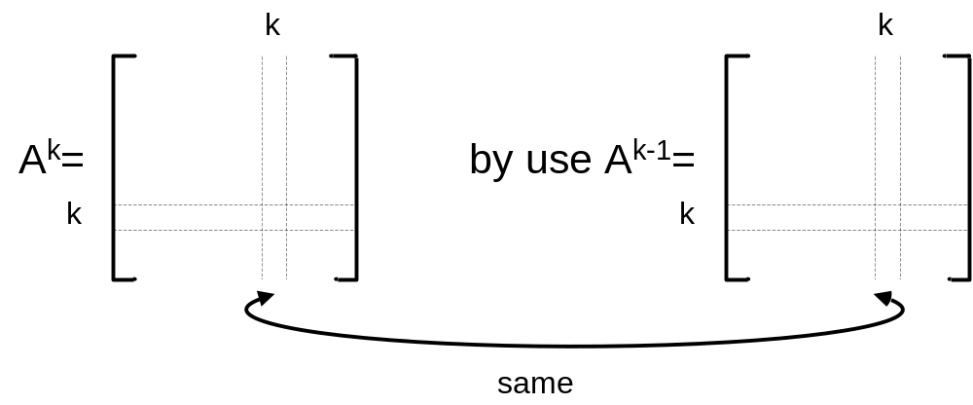
All-Pair Shortest Path Problem

Slide 34
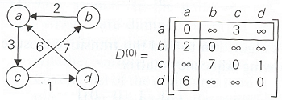
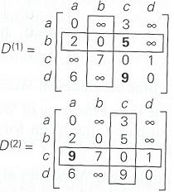
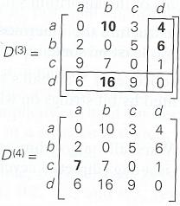

Slide 35
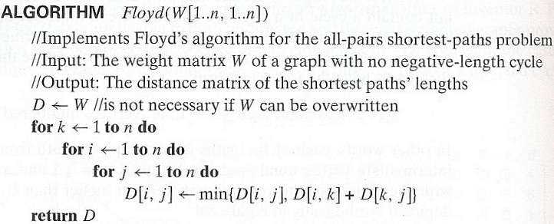
Floyd’s Algorithm
Time efficiency is cubic

Slide 36
All-Pair Shortest Path Problem
Floyd’s algorithm finds the lengths of shortest paths.
  What is the complexity?
    Time
    Space
How to find the actual paths?
  One of them
  All of them
  What is the complexity?
    Time
    Space

